Slide 1
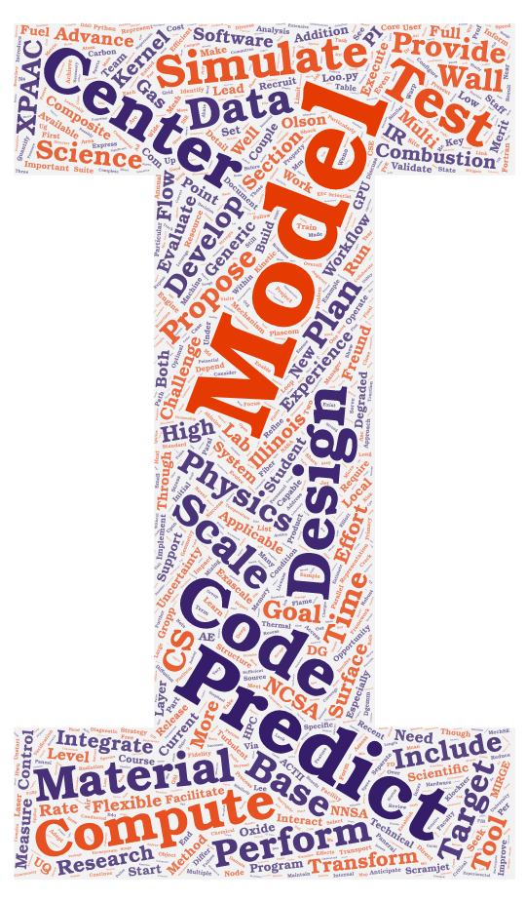
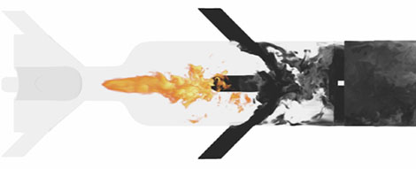
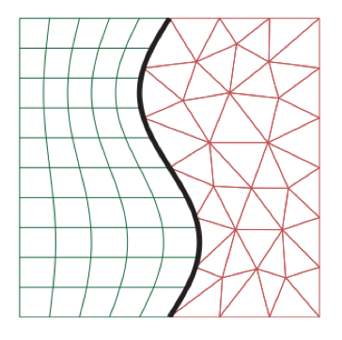
Preliminary Exam – Proposal Outline (December 2020)
Cory Mikida (AE)
Prof. Daniel Bodony (AE)
Prof. Andreas Klockner (CS)

Slide 2
Time Integration of Reacting Flows

Slide 3
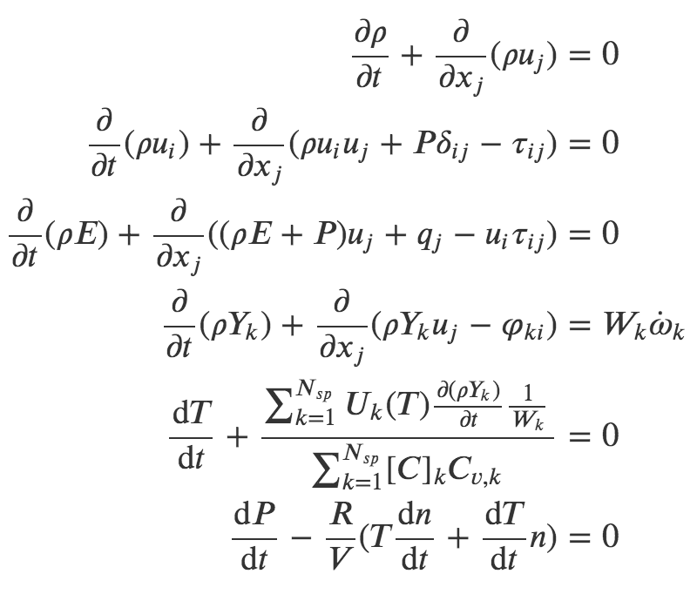
The Topic/Problem
The mission statement: develop stable, accurate, and efficient multi-rate time integration schemes for reacting flows
In these equations:
𝜌 = density
u_{i} = velocity in ith direction
𝛿_{ij} = Kronecker delta
𝜏_{ij} = fluid stress tensor
E = total energy
T = temperature
P = pressure
q = heat flux
W_{k} = molecular weight of kth species
ὠ_{k} = production rate of kth species
R = gas constant
n = number of moles of gas
[C]_{k} = concentration of kth species
C_{v,k} = specific heat at constant volume of kth species
U_{k}(T) = internal energy of kth species at temperature T
Y_{k} = mass fraction of kth species
𝜑_{ki} = diffusion flux of kth species
Ablation test (VKI)

Slide 4
The Topic/Problem
The mission statement: develop stable, accurate, and efficient multi-rate time integration schemes for reacting flows
Cons. of mass
Cons. of momentum
Navier-Stokes
Cons. of energy
Species mass fraction equation
Derived from constant internal energy assumption
Time derivative of ideal gas law
Ablation test (VKI)

Slide 5
The Topic/Problem
The mission statement: develop stable, accurate, and efficient multi-rate time integration schemes for reacting flows
Chemical source terms in governing equations tend to be stiff, setting the limiting timestep to be oppressively low relative to the fluid motion or requiring implicit treatment
Research Question: Can we derive performance benefit from using multi-rate Adams integrators?
Species production rates (stiff)
Ablation test (VKI)

Slide 6
Goals and Bounds
Must-have: demonstrate a novel scheme (adaptive implicit-explicit multi-rate) driving a canonical or demonstrative reacting flow problem (more) correctly and (more) efficiently
Current candidate problem: reacting mixing layer
See planning slides for more detail on this problem
Must-have: monitor and maintain presence of solution on constraint manifold (ideal gas law)
Fully differential approach to satisfying constant volume/constant internal energy assumptions can produce nonphysical solutions
Potential mitigation approaches: modified Jacobian to incorporate algebraic constraints, kinetic RHS attenuation (DAEs)
Ablation test (VKI)

Slide 7
Goals and Bounds (cont’d)
Nice-to-have: report on and/or optimize time integration within design space provided by multi-rate framework
Adaptivity choices (see next slide)
Evaluation order (”fastest-first” vs. ”slowest-first”, etc.)
Re-extrapolation?
Inclusion of additional history (shown in [1] to improve stability/timestep restrictions)
Nice-to-have: demonstrate tangible improvement over CVODE (state of the art) in at least one metric
Temporal order of accuracy, specifically when coupled with fluid solver
Number of chemistry RHS calls required to reach end time – proxy for performance improvement beyond simple walltime measurement
Beyond our bounds: multivariable solves incurred by certain situations (multiple coupled implicit RHSs, IMEX LTE)
Ablation test (VKI)

Slide 8
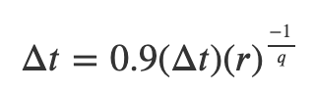
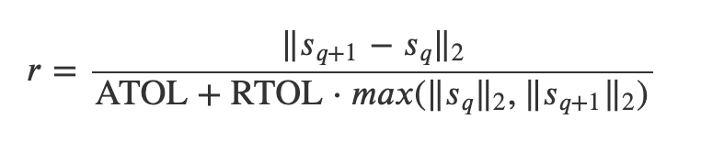
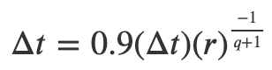
The Plan
Implement multi-rate Adams integrators (established as a viable vehicle for performance improvement by [1])
Add ability to integrate chemistry implicitly, and at a different timestep than that of the fluid motion
Coupling the chemistry with the fluid RHS will elevate temporal accuracy beyond that of the previous splitting approach (first order)
Timestep adaptivity also identified as critical need in early testing – add this capability to multi-rate Adams integration using local error estimates as with ODE45/CVODE
r >= 1
r < 1
q = order
s_{q} = state estimate obtained via explicit scheme of order q

Slide 9
The Plan (cont’d)
Adding adaptivity based on error estimates also introduces a number of design choices to be explored
Timestep adaptivity versus step ratio adaptivity
Incurs long-standing software research question of generating variable step-ratio multi-rate code
Step ratio adaptivity would make constant-timestep runs with error control possible, provided the fast component dominates overall error
Error control mechanism based on step ratio alteration may prove to be more efficient
Track local error/make adaptivity decisions based on subset of solution components?
Fast-evolving solution component (species mass fractions) may dominate local error
Confirming this would allow us to reduce overhead in terms of both memory and cost by refraining from tracking the slow component

Slide 10
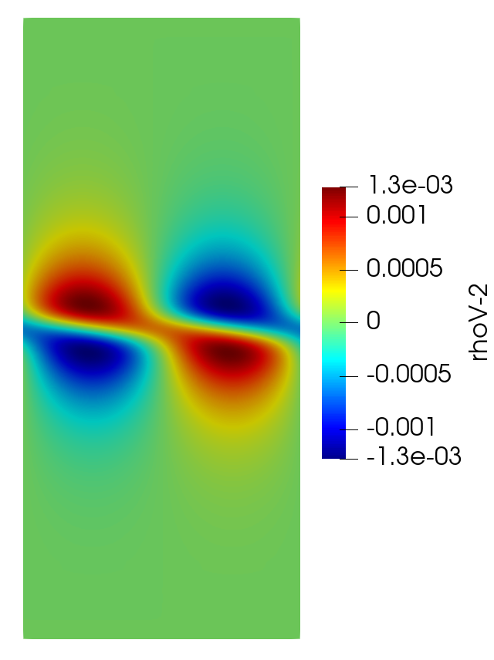
The Plan (cont’d)
Application: demonstrative reacting mixing layer problem
Hyperbolic tangent velocity profile as baseflow ([2], [3])
San Diego 9-species chemical mechanism
Initial condition: introduce temperature variation to localize autoignition to the mixing layer
This problem is suitable for our uses in that it provides multiple turnable ”knobs” for changing the rates of the fluid vs. the chemical kinetics, and vice versa
Scale magnitude of hyperbolic tangent velocity profile
Scale species production rates by altering reaction Arrhenius rates

Slide 11
The Plan (cont’d)
Application: demonstrative reacting mixing layer problem
Hyperbolic tangent velocity profile as baseflow ([2], [3])
San Diego 9-species chemical mechanism
Initial condition: introduce temperature variation to localize autoignition to the mixing layer
This problem is interesting and physically useful in that it provides the simplest relevant model of combustion in a scramjet/ramjet

Slide 12
Impact
Software: development of additional integration schemes within Leap/Dagrt framework, additional PyJac-V2 development
NASA9 thermodynamic polynomial descriptions already implemented in PyJac-V2 as added feature
Broader Impact: improved time-to-solution at high order for reacting flow problems
Subsonic/supersonic combustion for propulsion: gas turbines, scramjets/ramjets, rockets
Furnaces/residential heating
Atmospheric sciences
Ablation test (VKI)

Slide 13
Risk Mitigation
Important question: what if this doesn’t work out?
Reinforces CVODE as state-of-the-art for implicit treatment of chemical kinetics
However, a ”fallback” of sorts would be demonstrating a higher degree of temporal accuracy in the coupled fluid problem using a Leap-generated IMEX approach with PyJac-generated Jacobians
Given that these Jacobians are not finite difference, and given that this eliminates the splitting scheme currently employed (at best first-order), I’m much more confident in this as a preliminary outcome
Is this ”fallback” outcome interesting enough?
If so, should proving this (showing first order in splitting approach and higher-order with Leap RK approach on a demonstrative problem) be the initial goal?
If not, what is left?
Ablation test (VKI)

Slide 14
Current Status
Leap RK IMEX integration built into PlasCom2, using PyJac-generated chemical Jacobian for implicit solve
PyJac modified to include NASA9 thermodynamic polynomials (useful/required for maintaining accuracy for ignition problems with large temperature ranges)
Adams-Moulton integrators implemented as baseline for implicit treatment of chemistry in multi-rate Adams
Working its way through code review
Error-informed timestep adaptivity incorporated into single-rate and multi-rate Adams integrators
Local error estimate formed using explicit methods of differing orders
Multi-rate implementation needs to be tested w/stiff problem
Ablation test (VKI)

Slide 15
Current Status (cont’d)
Implicit-explicit multi-rate w/adaptivity in development
Fluid solver requires incorporation of mass diffusion terms in governing equations
Reacting mixing layer in development (demonstrative case)
Currently struggling to stand up simulation
As of 12/28, cold flow case with unstable mode as initial condition is running
This is functioning to eyeball norm, but growth rate/physics need to be verified before introducing temperature variation/ignition
Whether the unstable mode still provides a good initial condition in the reacting case is unclear and needs to be determined
One-dimensional premixed laminar flame
Functioning as a baseline case to compare reacting fluid solver’s estimated laminar flame speed with steady-state analysis (Cantera)
Ablation test (VKI)

Slide 16
Energy-Stable Hybrid Spatial Discretizations

Slide 17
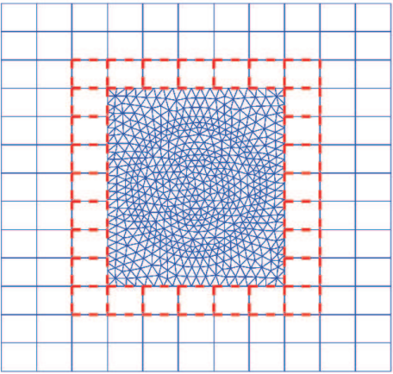
The Topic/Problem
The mission statement: create a stable and accurate interface between structured (SBP) and unstructured (DG) spatial discretizations
Introducing localized regions of unstructured meshing allows for superior meshing of complex geometries
Most approaches to this present in literature appear to have at most second-order accuracy
Few approaches provide any claims about stability
Image credit: “A hybrid FETD-FDTD method with nonconforming meshes”, Zhu et. al
Ablation test (VKI)

Slide 18
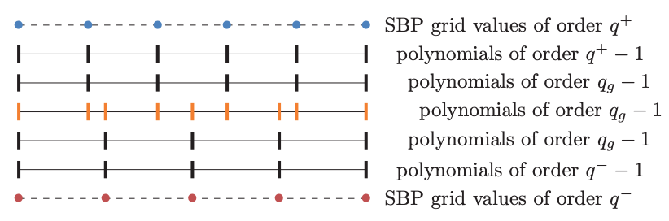
The Topic/Problem
Starting point: nonconforming interface method of Kozdon and Wilcox ([4])
Boundary between spatial schemes traversed via projection of solution into “glue grid” polynomial space
Choice of polynomial space in glue grid/structure of projection operators can allow for proof of energy stability
However, resulting projection stencils give an underdetermined system, with optimization used to produce final projection operators
Illustration of glue-grid method in traversing nonconforming SBP-to-SBP boundaries.
Ablation test (VKI)

Slide 19
The Topic/Problem/Impact
Research Question: can we make stability guarantees in a manner similar to this work while avoiding ad-hoc/optimization-based approach to operator construction?
Draft theorem to prove: If a function defined on a finite-difference mesh is coupled to an unstructured mesh via a nonconforming interface, the coupling is stable and accurate to order q provided the projection operators from finite-difference to unstructured (and vice versa) satisfy condition X.
Broader Impact: improved flexibility in modeling fluid problems with complex geometries
Provide alternative to overset/multiblock curvilinear meshing for such problems
Locally introduce shock-handling benefits of DG into previously finite-difference-only simulations with relative ease
Ablation test (VKI)

Slide 20
Goals and Bounds
Must-have: stable, accurate, and *unisolvent* approach to interior projection from structured (SBP) to unstructured (DG) meshes in 2D
Unisolvent: same number of unknowns (DOFs) as constraint equations
Seek one-to-one projection: round trip across interface does not result in data loss
Apply this to a periodic problem as a baseline proof-of-concept
Nice-to-have: application to 3D problems
Nice-to-have but based on our current experience will be tricky: stable, accurate, and unisolvent boundary projection
Boundary stencils are currently what make the whole-operator solves of Kozdon and Wilcox underdetermined
Ablation test (VKI)

Slide 21
The Plan
Starting point: remove more complicated boundary treatment from setup, construct interior-only periodic projection operators
Be able to write down time-continuous proof of stability (via energy) - this may result in a different operator condition than K+W’s compatibility, and may require a more thorough search for all possible operator conditions than has yet been performed
Establish a sensible set of DOFs
Solve for these operators from a square system based on accuracy conditions for projection in *both* directions (grid-to-glue, glue-to-grid), in addition to any constraints we need to impose to ensure stability (based on conditions mentioned above)
Ablation test (VKI)

Slide 22
The Plan (cont’d)
Prove the efficacy of these projection operators in 2D
Demonstrate code that solves set of constraint equations for set of unknowns to produce projection operators (and provide as electronic supplement)
Practically demonstrate order of accuracy of projection across interface using L2 error
Numerically demonstrate non-increasing energy on demonstrative problem, and compare numerically observed energy rate-of-change to that derived by the energy stability proof
Apply lessons learned to boundary treatment
Ablation test (VKI)

Slide 23
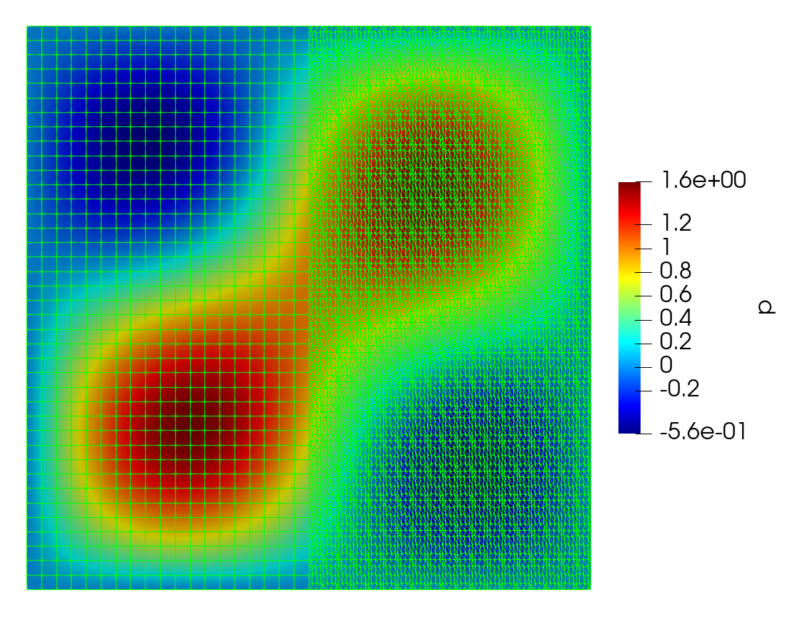
The Plan (cont’d)
Application: 2D acoustic wave equation on split domain
Ablation test (VKI)

Slide 24
Risk Mitigation
Important question: what if this doesn’t work out?
Can try to establish more concretely why Kozdon and Wilcox’s underdetermined result is truly the best one for our purposes while highlighting suspect error behavior at boundary
Can attempt to extend this method to 3D (not done in their paper/unclear what challenges this could potentially pose)
Can also determine whether there is a timestep limitation imposed by Kozdon and Wilcox’s method, and – if so – attempt to expose the coupling to multi-rate for performance improvement
Is this ”fallback” outcome interesting enough?
If not, what is left?
Ablation test (VKI)

Slide 25
Current Status
Python-based testing setup created which implements split-domain 2D acoustic wave problem described on the previous slide
SBP-side boundary fluxes incorporated into DG software package
Energy stability verified with Kozdon and Wilcox’s operators via comparison of numerically observed energy rate-of-change and that used in their energy stability proof
Matlab and Maxima codes written with the goal of experimenting with different DOF/constraint setups to produce a unisolvent and stable interior projection operator
Needed: firmer understanding of how compatibility condition of K+W fulfills interior projection operator accuracy constraints in both directions (pencil and paper)
Needed: experimentation with alternatives to compatibility condition – how to find out whether any other suitable operator conditions exist?
Ablation test (VKI)

Slide 26
References
[1] Mikida, Cory, Andreas Klöckner, and Daniel Bodony. "Multi-rate time integration on overset meshes." Journal of Computational Physics 396 (2019): 325-346.
[2] Michalke, Alfons. "On the inviscid instability of the hyperbolictangent velocity profile." Journal of Fluid Mechanics 19.4 (1964): 543-556.
[3] Blumen, William. "Shear layer instability of an inviscid compressible fluid." Journal of Fluid Mechanics 40.4 (1970): 769-781.
[4] Kozdon, Jeremy E., and Lucas C. Wilcox. "Stable coupling of nonconforming, high-order finite difference methods." SIAM Journal on Scientific Computing 38.2 (2016): A923-A952.
Ablation test (VKI)

Slide 27
Changelog (v1 – v2)
Time Integration of Reacting Flows:
Removes initial (useless) outline slide
Made significant attempt to clarify/explain governing equations and notation (Topic/Problem)
Poses usage of multi-rate to improve performance as a question rather than a given (Topic/Problem)
Expands “Goals and Bounds” into two slides in order to include more detail on these goals, in particular the initial must-have (stating the current candidate problem) and expounding upon adaptivity choices and potential success metrics
Expands the first plan slide into multiple slides, both in an attempt to flesh out the mathematical model behind the error control scheme, and to further elaborate on adaptivity choices as worth exploring
Removes software tool discussion from the Plan (instead adding this in brief to the impact slide, as directed), and further fleshes out the usefulness/appropriateness of the reacting mixing layer as a demonstrative problem
Adds an Impact slide (software + broader impact)
Adds a Risk Mitigation slide (“what if this doesn’t work out?”)
Expands Current Status slide into two slides, largely in an effort to increase frankness
Ablation test (VKI)

Slide 28
Changelog (v1 – v2) (cont’d)
Energy-Stable Hybrid Spatial Discretizations:
Adds to the Topic/Problem slides to hash out why the problem is interesting based on existing work, and what the primary research question is, as well as a neat picture
Adds broader impact as well as draft theorem to prove to final Topic/Problem slide
Elaborate in Goals and Bounds on what exactly unisolvency is/what our ideal projection operator would look like
Removed any mention of software, as my software impact on this side of things will likely prove minimal
Elaborate in the Plan section on what “efficacy” of projection operators implies
Adds Risk Mitigation slide similar to Time Integration section
Adds to Current Status slide to better document where we left off with the 2D acoustic wave simulation
Ablation test (VKI)

